Slide 1
‘Graduation’ in Social Protection Programmes
Washington DC, 29th – 30th September 2011
Rachel Sabates-Wheeler

Slide 2
Outline
Outline
The remit of Social Protection
How does SP facilitate development objectives
Graduation for anti-poverty programming
Some examples
Implications for comprehensive programming

Slide 3
The Remit of SP (I)
The Remit of Social Protection
First tier objectives: to tackle
vulnerability;
poverty and
exclusion from social protection provision.
Second tier objectives: to promote
pro-poor and inclusive development and;
economic growth

Slide 4
Graduation - the theory!
assets
Asset accumulation path
A_{np}
Dynamic accumulation
A*
A_{p}
Dynamic dis-accumulation
A_{vp}
time
Notes:
Theory of change:
There exists a substantial proportion of poor people/households who are more risk-averse and less productive than they could be, due to a) lack of resources (income and assets); b) high-risk environments; c) lack of credit; d) lack of know-how.
If income/assets/resources are provided, individuals/households will be able to build their asset base, thus building resilience to future shocks (enabling the first structural transition in Figure 1 and minimising negative stochastic transitions as in Figure 1).
Furthermore, the regularity of predictable payments will insure against downside risk and enable beneficiaries to move into activities with a higher return/higher productivity (enabling the second structural transition in Figure 1).
Over time beneficiaries’ lives and livelihoods will be transformed in a sustainable way, allowing them to support themselves so they are able to ‘graduate’ off external support (Figure 2).
Local multiplier and spill-over effects from more productive and market-engaged households will have a positive aggregate effect that is bigger than the sum of all the individual household effects.
This type of transformation will be ‘virtuous’, in the sense that strengthened, more resilient livelihoods characterised by higher levels of productivity will have a self-sustaining momentum with pro-poor growth effects.

Slide 5
The requirements of this remit!
Theory of Change
There exists a large amount of risk adverse poor people
If resources are provided these people will be able to productively build their asset base
Regularity of predictable payments will insure against downside risk leading to entrepreneurial activity
Livelihoods will be transformed in a sustainable way allowing beneficiaries to ‘graduate’ off the programme
Local multiplier and spill-over effects will mean that positive effects are felt more widely than just by the beneficiaries
This type of transformation will be ‘virtuous’ – self-sustaining and supporting pro-poor growth

Slide 6
The requirements of this remit!
Some examples
Bangladesh Ultra-Poor Programme
Ethiopia’s Food Security Programme
Rwanda’s ‘Vision 2020’ SP programme
US Welfare-to-work Programmes
Ghana’s LEAP Programme
Mexican OPORTUNIDADES

Slide 7
Food Security Programme –Ethiopia
Productive Safety Net Programme (PSNP) represents an historical shift from the relief system to a predictable transfers system
smoothing HH food consumption & protecting assets;
strengthening HH resiliency to (modest) shocks;
break Ethiopian’s dependence on food aid introducing a cash first principle
PSNP is part of the GoE Food Security Programme
- It has the potential to evolve into a comprehensive social protection strategy (CSP)
Notes:
Take the Development paper for distribution

Slide 8
FSP –Ethiopia:
the enabling environment
PW
Food Security
Productive Safety Net Programme
DS
Food Security
Food Insecure Households in CFI woredas
HH Asset Building Programme
Community Complementary Investments
Resettlement Programme
Notes:
PSNP : 100% donors funded
HABP, CCI, Resettlement : 100% GoE funded
HABP : creating new assets through technical packages and financial support (micro credit)
CCI : Community Infrastructures (Roads, health, water, irrigation…) more capital intensive
CFI = Chronically Food Insecure (woredas, HH…)

Slide 9
Graduation in the PSNP (1)
“A household has graduated when, in the absence of receiving PSNP transfers, it can meet its food needs for all 12 months and is able to withstand modest shocks”
Notes:
Ask participants from Ethiopia

Slide 10
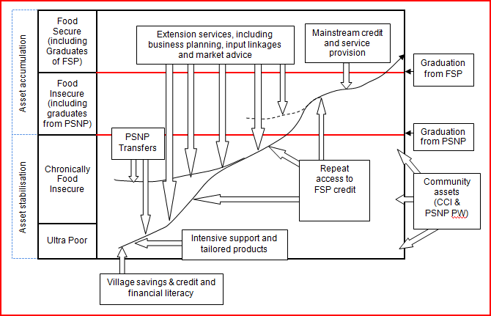
Graduation in the PSNP (2)

Slide 11
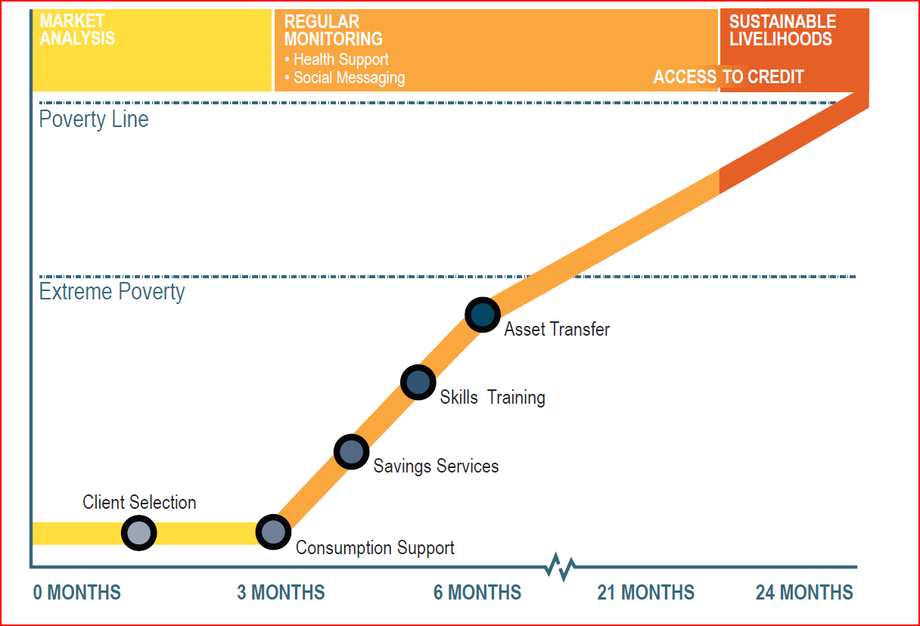
Bangladesh BRAC
Bangladesh -BRAC

Slide 12
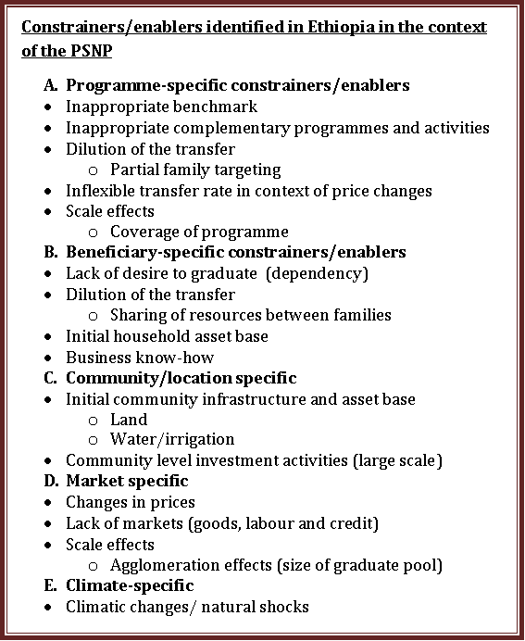

Slide 13
Threshold graduation vs sustainable graduation
Threshold graduation describes a process whereby recipients of support move from a position of depending on external assistance to a condition where they no longer need this support, and can therefore exit the programme.
Sustainable graduation clearly requires threshold graduation to be met, however this is not hold in the reverse case. This is because sustainability of a strengthened livelihood is time-dependent and requires a measure of resilience in the face of a negative change.
Notes:
While critical for programming and budgetary purposes, the ‘threshold’ emphasis within the graduation discussion is somewhat of a ‘red herring’ as a national or regional (even district) threshold for graduation will be extremely difficult to apply uniformly across the beneficiary population given the massive range in different resources and livelihoods pursued. We know from evidence that such benchmarks, once attempts are made to apply them, become malleable and locally-specific for this reason (see PSNP fieldwork + Sandford et al.). Therefore, the point of reference in relation to long term outcomes of social protection should be whether households are generally experiencing a positive transformation in their livelihoods such that over time livelihoods are strengthened and become more resilient. Here we lay out the factors that are likely to constrain (and by deduction, enable) sustainable graduation – or transformed, strengthened livelihoods.

Slide 14
The reality
assets
Asset accumulation path
A_{np}
Markets; climate….
A*
A_{p}
Scale; coverage…..
A_{vp}
time
Notes:
Graduation into what? Where is that discussion?

Slide 15
Transfer dilution
‘Transfer dilution’ occurs when less than the originally planned per capita transfer reaches the intended beneficiary, in the interests of including more beneficiaries in the programme.
Full-Family/Full targeting is when all members of the household receive their full entitlement

Slide 16
Transfer dilution: programme-specific
In a recent evaluation of the PSNP in pastoralist areas we examine the extent to which full-family targeting (FFT) was being practiced. In the quantitative household survey instrument we recorded the amount of grain payments received, by month between December 2009 to November 2010.
We use this information to tabulate, by woreda, mean levels of grain payments and household size. We show just five woredas here.
If FFT is being practiced, we expect to see payment levels rising with household size

Slide 17
Total grain payments by household size

Slide 18
Total grain payments by household size, Erer

Slide 19
Total grain payments by household size, Gursum

Slide 20
Total grain payments by household size, Dolo Odo

Slide 21
Total grain payments by household size, Harsin

Slide 22
Scattergram of coverage and per capita transfers

Slide 23
Transfer Dilution: Beneficiary-specific
Sharing in polygamous households
In Ewa and Teru, the husband is registered with one of the wives and children. Husbands decide how to share out the transfer amongst the rest of the wives, often depending on the size of each unit.
A culture of sharing
In our society there is a resource sharing culture. Moreover, there are no significant wealth variations amongst a majority of the community members. We believe that food security can be realized at the community level not at the household level as it is stated in the program document (PSNP PIM). When it comes to Afar food security has to be viewed in this way. In Afar almost everything is communal.

Slide 24
Can social protection participants graduate?
Constraints to graduation – Design:
Transfers are too small, limited duration, or erratic.
Inadequate support to “livelihood promotion”.
Some people will never graduate!
Constraints to graduation – Context:
Economic: Weak markets, high structural unemployment.
Services: Poor education and health services.
Vulnerability: Livelihood shocks can negate gains.

Slide 25
The requirements of this remit!
Critical factors for comprehensive programmes?
Coordinated development across sectors
Social protection systems not just programmes
Predictable and sustainable financing
A long term vision/programme
Strong political commitment
Context appropriate
Cross-sectoral initiatives
Post-project/long-term M and E

